Slide 1

NATURAL LANGUAGE PROCESSING(NLP) PROJECT:FINANCIAL TEXT MINING
METRO COLEGE DSP PROJECT :MUWANI ROBOSN
Date:30 May 2020

Slide 2
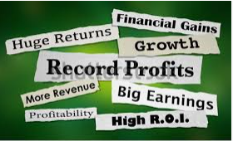
Objectives
Business Problem
Hypothesis Generation
Exploratory Data Analysis
Data Cleaning
Feature Engineering
Model Building
Model Results Analysis
Summary (conclusion & Recommendations)
Q&A

Slide 3
BUSINESS PROBLEM
Making investment decisions based on relevant financial information is a predominant challenge for modern investors.
Now, even obscure companies produce a constant stream of information, from the daily price fluctuations in the stock to announcements and posts on dedicated message boards. When information floods in, it can be difficult to pick out what is important.
Current approaches to mine sentiments from financial texts largely rely on domain-specific dictionaries. However, dictionary-based methods often fail to accurately predict the polarity of financial information.
The aim is to build a predictive model and find whether the news may have positive, negative, or neutral influence on the stock price. As a result, sentences which have a sentiment that is not relevant from an economic or financial perspective are considered neutral. Using this model, the financial phrase bank will help prospective investor to know which news headlines will have an impact on the stock market prices.

Slide 4
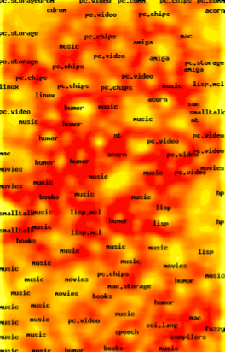


FINANCIAL TEXT MINING(NEWS HEADLINES)
THE STUDY:
The data covers release of the financial phrase bank with a collection of 4846 sentences in the form of financial news headlines.
The study is focused only on financial and economic domains.
The aim is to build a predictive model and find whether the news may have positive, negative, or neutral influence on the stock price.
As a result, sentences which have a sentiment that is not relevant from an economic or financial perspective are considered neutral
Model Analysis is based on NLP

Slide 5
HYPOTHESIS GENERATION
Financial Sentiment Hypothesis Criteria
Positive sentiments: news headlines containing positive sentiments are on average less than 50 words. Existing words or phrases contain statements like company posting good profitability indicators, gain in earning per share, signing on new mega investment projects, growth prospects via mergers and acquisitions tend to increase the stock price of any share. Investors tend to take a buy or sell position, speculating for future gains or some take a sell position to reap the cumulative gains.
Key investments decision/strategy is :buy or sell position
Negative sentiments: more verbose, words average more than 100. Additionally, negative reports, negative profits, decline in earnings per share and negative news reports results in negative sentiments hence decline in stock market prices. Investors will recommend to sell or to liquidate the asset.
Key investments decision/strategy is :liquidate or hold
Neutral sentiments: general financial news with no impact on stock prices. Investors tend to take wait and see scenario or just a hold on position.
Key investments decision/strategy is :wait and see or hold position

Slide 6

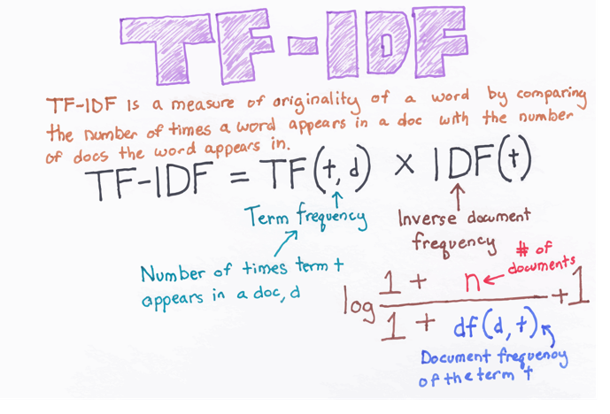
NLP MODEL SUMMARY
NLP (Natural Language Processing)
is a set of techniques for approaching text problems. It is an approach to communication, personal development, and psychotherapy created by Richard Bandler and John Grinder in California, United States in the 1970s. The followings are his definition of NLP
TF_IDF ENCODING
STOP LISTS
STEMMING
TURNING DOCUMENT INTO A VECTOR
BAG OF WORDS

Slide 7
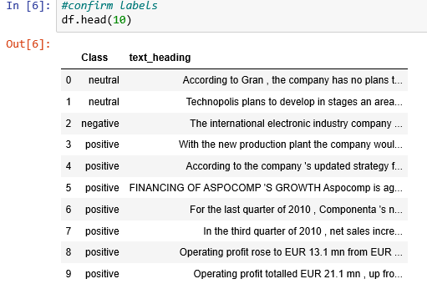
DATA READING
Above shows how the text appears after reading it in Jupiter Notebook

Slide 8
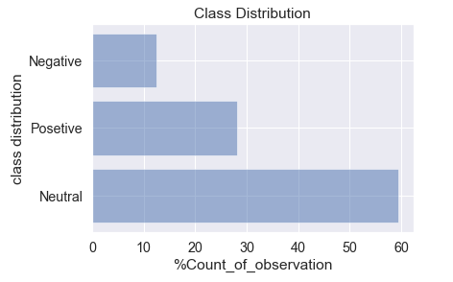

EXPLORATORY DATA ANALYSIS
Neutral sentiments constitute 59% of the total dataset while negative sentiments takes the baseline record of 12% from the data set.
This is normal for a healthy economy, most news headlines must not trigger stock prices movements.

Slide 9
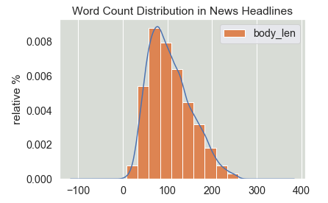
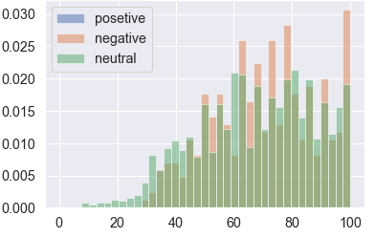
WORD COUNT DISTRIBUTION
Most financial news contains an average of 100 words in length
Negative news headlines contained more words than the rest of the class.
Negative class top for most news headlines with words exceeding 50.
Neutral statements top for news headlines less than 50

Slide 10
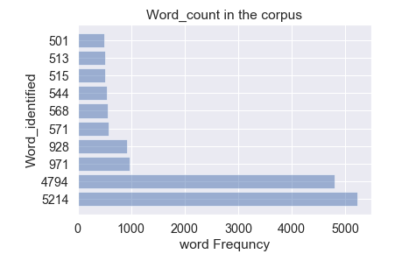
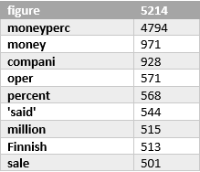
WORD FREQUENCY ANALYSIS
Most popular 10 words in the news headlines are figure, money, money percent as depicted by the plot above.

Slide 11
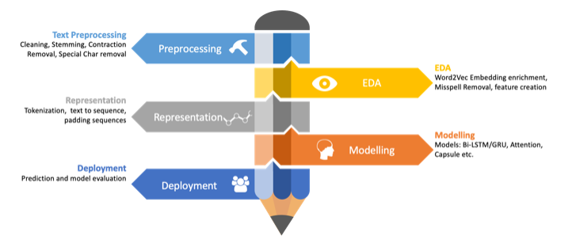
BUILDING THE NLP MODEL
NLP MODEL PROCESS:
Text preprocessing
Basic features
Word features
Vectorization(bag of words)

Slide 12
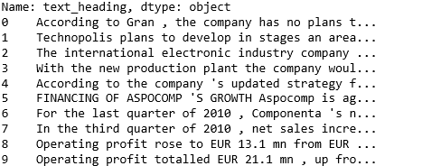
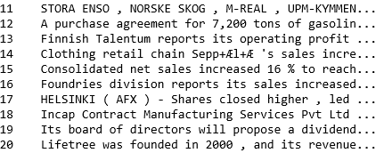
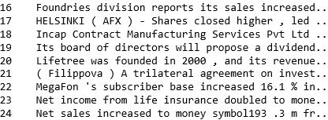
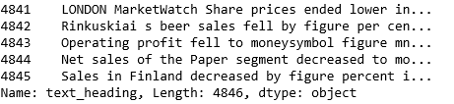
NEWS HEADLINES APPEARANCE

Slide 13
DATA PREPROCESSING
Text cleaning:
Changing figures to read as money
Changing phone numbers to read as phone numbers
Money symbols to read as money symbols/money
Percentage sign(%) to read as percentage
Removing alphanumeric characters
Changed the text to lower case
Removed white space
Remove punctuation
Stemming and lemmatization

Slide 14
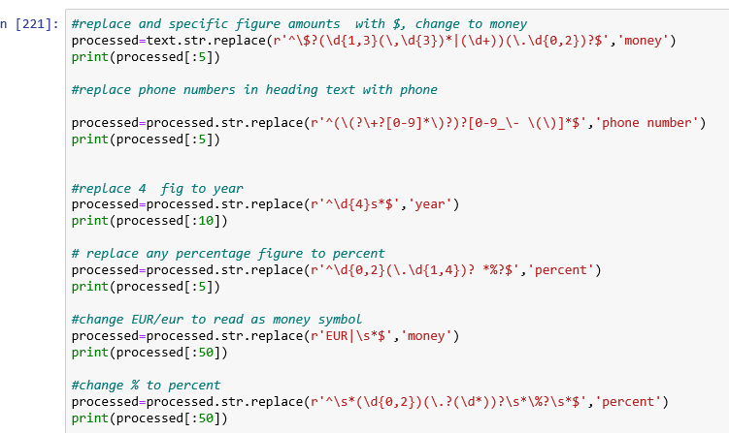
SAMPLE TEXT CLEANING:REGEX FUNCTIONS

Slide 15

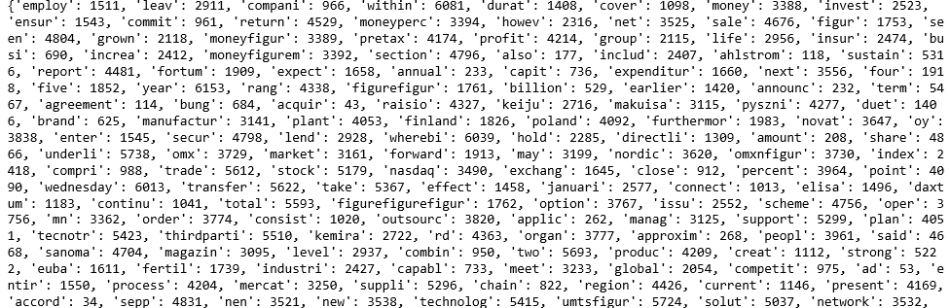
FEATURE ENGINEERING:BAG OF WORDS MODEL
FINANCIAL TEXT
Stopwords are words which do not contain enough significance to be used without our algorithm. We would not want these words taking up space in our database, or taking up valuable processing time. For this, we can remove them easily by storing a list of words that you consider to be stop words.
Tokenization is the act of breaking up a sequence of strings into pieces such as words, keywords, phrases, symbols and other elements called tokens. Tokens can be individual words, phrases or even whole sentences. In the process of tokenization, some characters like punctuation marks are discarded.

Slide 16
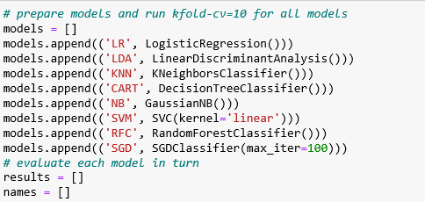
MODELS DEPLOYMENT

Slide 17
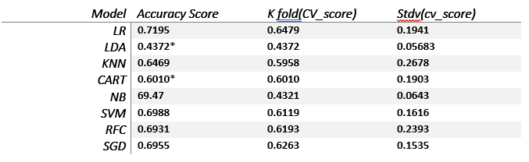
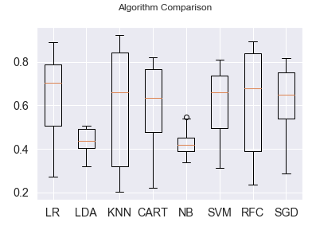
MODEL RESULTS ANALYSIS
Logistic regression performed better than all the models, recording an accuracy of ~72%.
SVM, SGD, Random Forests and KNN all recorded an accuracy of ~70%~70%,~69% and ~65% respectively
Worst performing models were LDA and NB, all below
There was greater variability in all model that performed better scores @K fold model validation at cv=10 was lower than the obtaining accuracy score

Slide 18
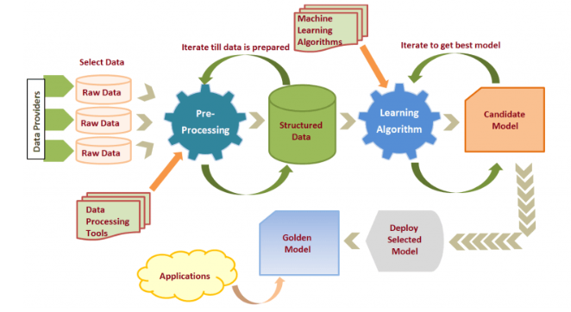

MODEL IMPROVEMENT
Steps taken:
Shuffling the featureset: to eliminate bias in models
Ensemble method :Ensemble methods are meta-algorithms that combine several machine learning techniques into one predictive model in order to decrease variance (bagging), bias (boosting), or improve predictions (stacking)

Slide 19
SUMMARY FINDINGS
Logistic regression presented as a better model in predicting the polarity of financial news headlines. However, the score signify need for improvement through use of best hyper parameters (Gridsearch).
Model improvement was applied via ensemble method, score went up to 73%.
NB,SGD ,RFC and SVC presented alternative accuracy scores but needs great improvement.
Great variability was observed in K-fold accuracy scores in all models that performed better, test scores and accuracy score almost the same for all the models that did not perform well.
K fold score stdv was too high for all models that performed better ( variance between the k-fold scores, for cv=10).
LDA, KNN and CART models proved to be the worst models in predicting the financial text sentiments. The model accuracy score were less than 60% and thus not acceptable models.

Slide 20
RECOMMENDATIONS
The obtaining results show suitability of Logistic Regression as a better model in predicting the polarity of financial text for this data set. Therefore I recommend using this model with great caution to avoid overfitting. The model accuracy can further be improved by selecting best parameters and hyper parameters.
Alternatively, Use of ensemble method: thus select all models with average score of 70% and run an ensemble method with only better models (L R,NB,SGD ,RFC and SVC ).
Add more data-for models with high variance high variance of predictions it is ideal to increase the training set size. Try increasing your sample by providing new data, which could translate into new cases or new features.
Data Preprocessing & Feature engineering-apart from transformations, creating new variables out of existing variables is also very helpful. to create new features that improve the model’s performance. Every new feature can make guessing the target response easier. Automatic feature creation is possible using polynomial expansion or the support vector machines class of machine learning algorithms. Support vector machines can automatically look for better features in higher-dimensional feature spaces in a way that’s both computationally fast and memory optimal.
Consider applying deep learning models such as Recurrent Neural Networks (RNN). These are good for processing sequence data for predictions. Two models can be tried LSTM and GRU models. LSTM’s and GRU’s were created as a method to mitigate short-term memory using mechanisms called gates. Gates are just neural networks that regulate the flow of information flowing through the sequence chain.

Slide 21


